Slide 1

Palak Upadhyay
Enrollment/roll no. – 2410031609
Program & Semester – B.tech (CSE)
Section - 3cse16
AICTE ID - STU6998afa4101851771614116

Slide 2
AWS CLOUD INTERN
AICTE – EDUSKILL VIRTUAL INTERNSHIP
INTERNSHIP DURATION – 1 AUG 2026 – 29 SEPT 2026

Slide 3
Candidate and program overview
Candidate detail
Student Name – Palak Upadhyay
Stream – B.tech
Branch – CSE(Cyber Security)
Institution – IILM University, Greater Noida
AICTE Student_id - STU6998afa4101851771614116
Internship Profile
Program name – AICTE – Eduskill Virtual Internship
Internship Domain – AWS CLOUD INTERN
Duration 8 weeks(august 2026 – October 2026)
Offer letter Ref - C18Y2026M081529883
Status – Selected for 8 – week Virtual Internship

Slide 4
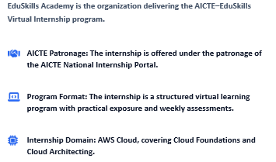
Program And Organization Overview

Slide 5
Internship Purpose, Evalution & Completion
Evalution & Completion
The internship follows a week – wise learning plan with weekly assessments, project documentation and assignments.
The final grade is based on weekly assessment, project submission and final assessment test . Successful completion leads to a virtual internship certificate
Internship Purpose
The program is designed to provide structured learning combined with pratical exposure in AWS Cloud
The internship helps build industry – revelant skill that enhance employabilty and confidence in the subject area

Slide 6
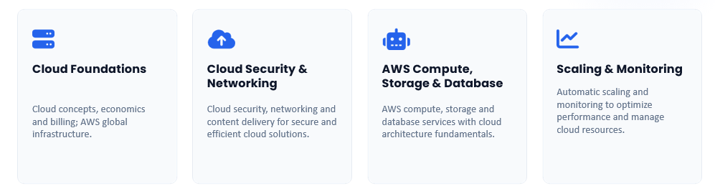
CORE AWS CLOUD LEARNING AREAS

Slide 7
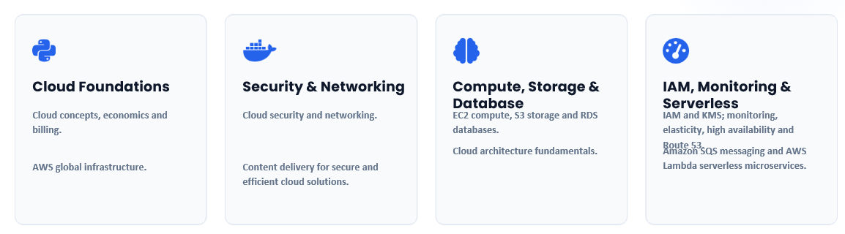
AWS Technologies & Services covered

Slide 8
AWS Cloud Learning Scope
Cloud Foundation: Cloud concepts , economics, billing and AWS global infrastructure.
Security & Networking : Cloud security, networking and content delivery.
Cloud Architecture : IAM , S3, EC2,RDS,VPC and VPC peering
Advanced cloud : KMS , monitoring , elasticity, high availability and Route 53.
Serverless & Data : SQS, Aws Lambda, Dtat Engineering pattern, disaster recovery and solution architect preparation

Slide 9
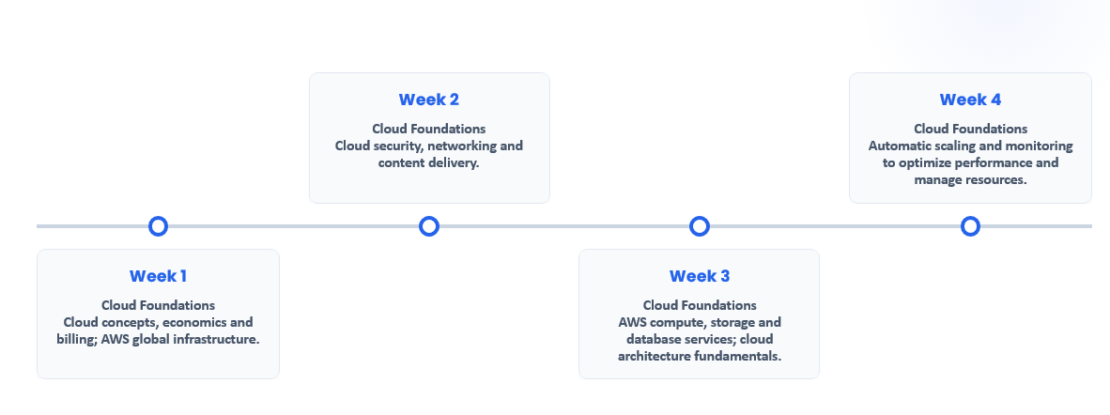
Curriculum Timeline (Weeks 1 to 4)

Slide 10
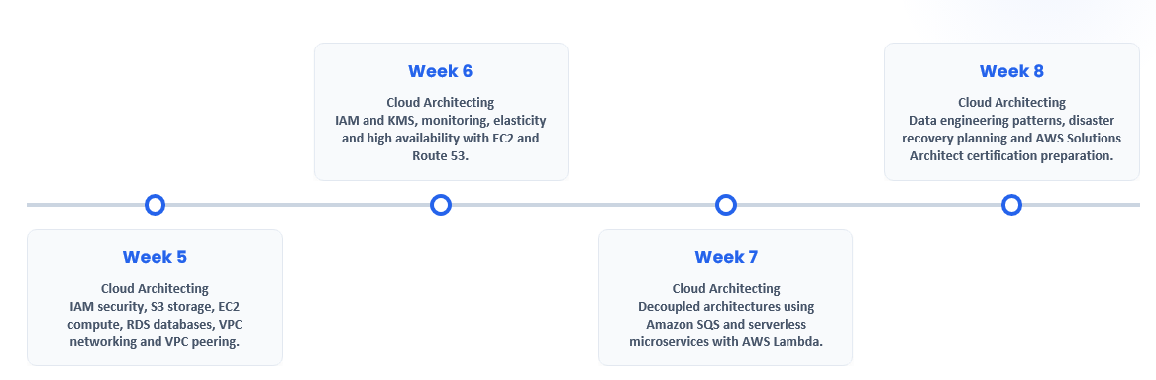
Curriculum Timeline (Weeks 5 to 8)

Slide 11
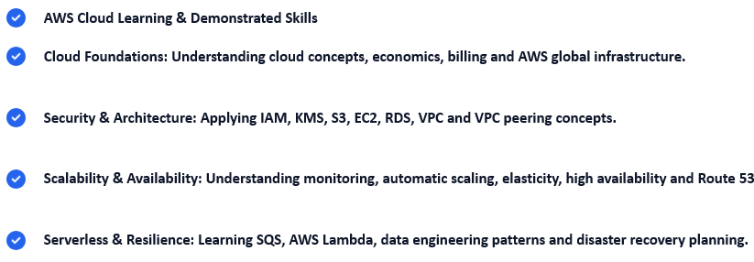
Learning Area And Expected Skills

Slide 12
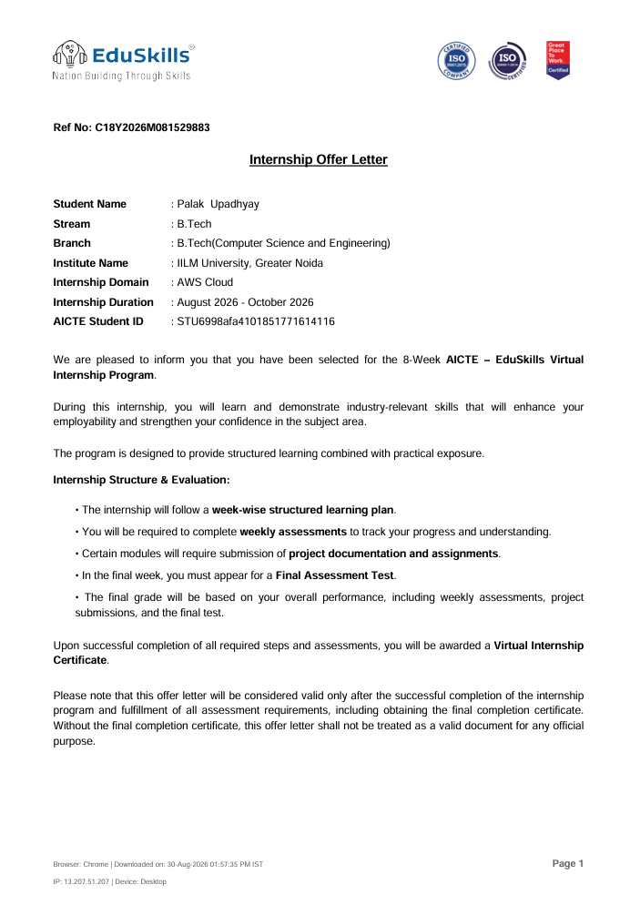

Slide 13
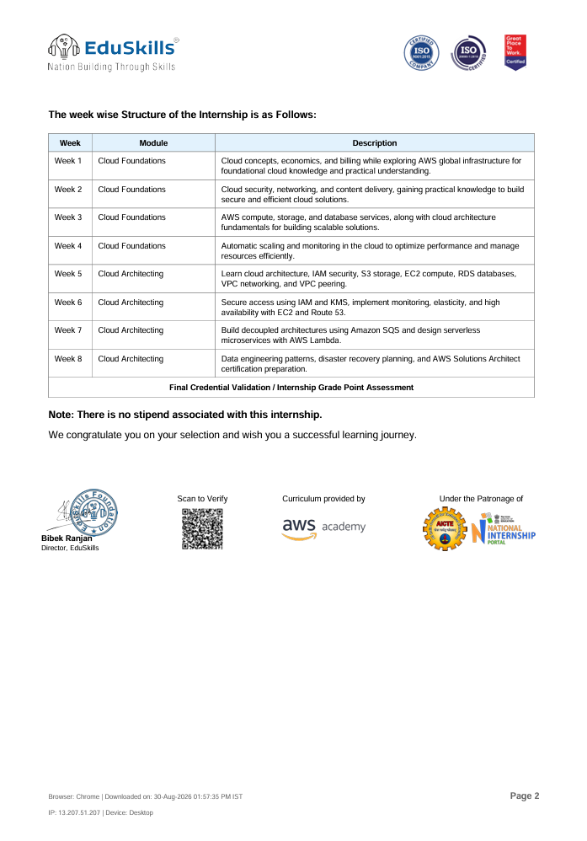

Slide 14
